Slide 2
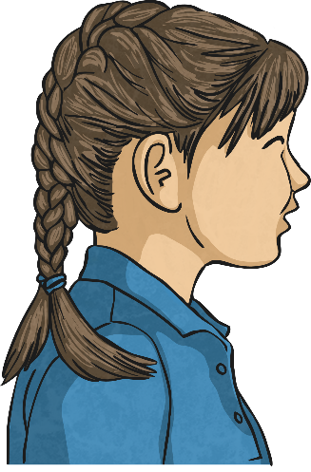
S U S
^{Study the word.}
^{Underline the difficult part.}
^{Say the word carefully.}

Slide 3
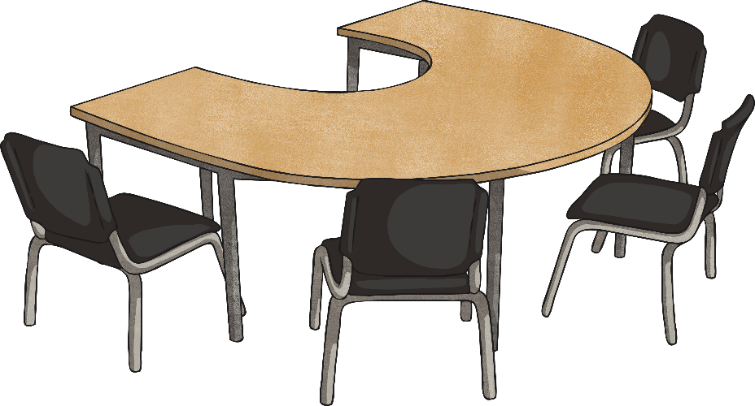
Writing the Word
^{On someone’s back.}
^{On your desk.}
^{With your eyes.}

Slide 4
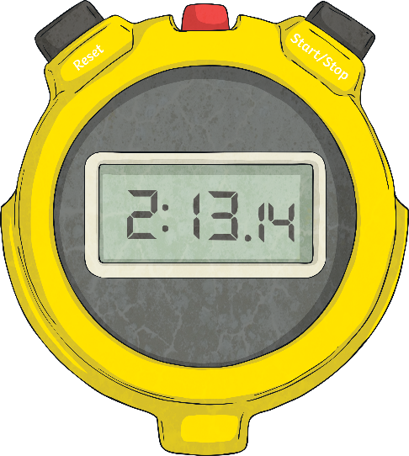
Speed Writing
How often can you write the word correctly in one minute?

Slide 5
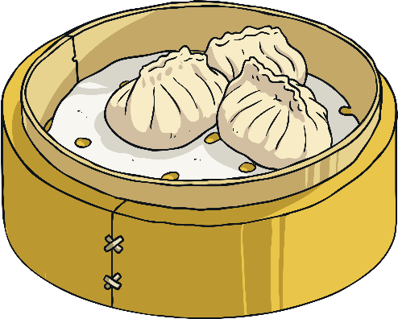
S A D
Mnemonics
Making up a ‘story’ to help spell a word.
^{Sally ate dumplings.}

Slide 6
Syllables/ Chunks
^{Breaking the words}
^{into parts.}
^{Clapping the sounds.}
^{jogging}
^{flying}
^{returned}
^{jogg ing}
^{fly ing}
^{re turn ed}

Slide 7
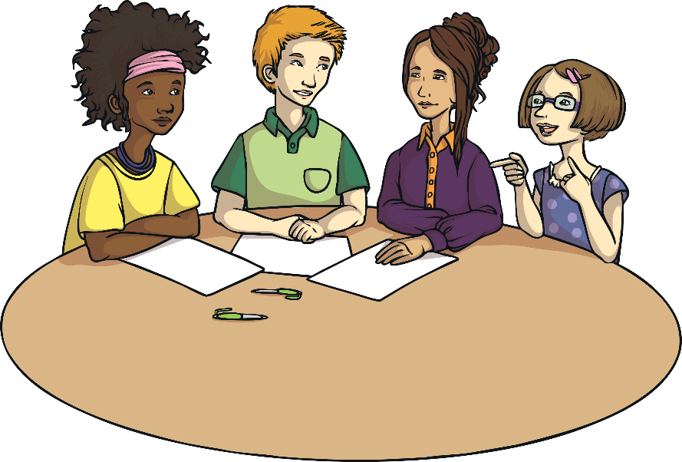
Look For Small
Words Inside the Word
^{about}
^{teacher}
^{a, out, bout}
^{tea, each, her, ache}

Slide 8
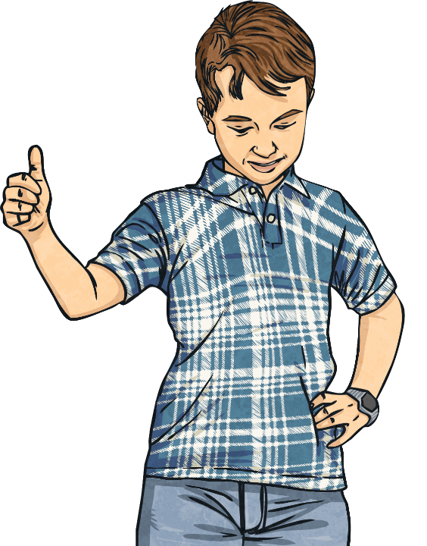
Be Positive
^{We will try our best!}

Slide 9
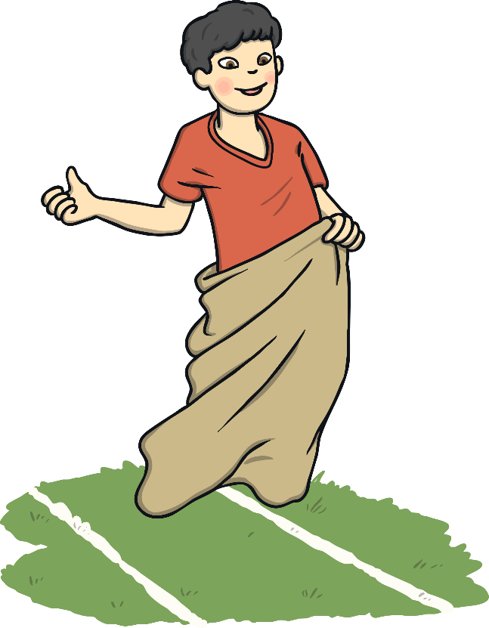
Words That Look
the Same
^{Back is like pack and sack.}

Slide 10
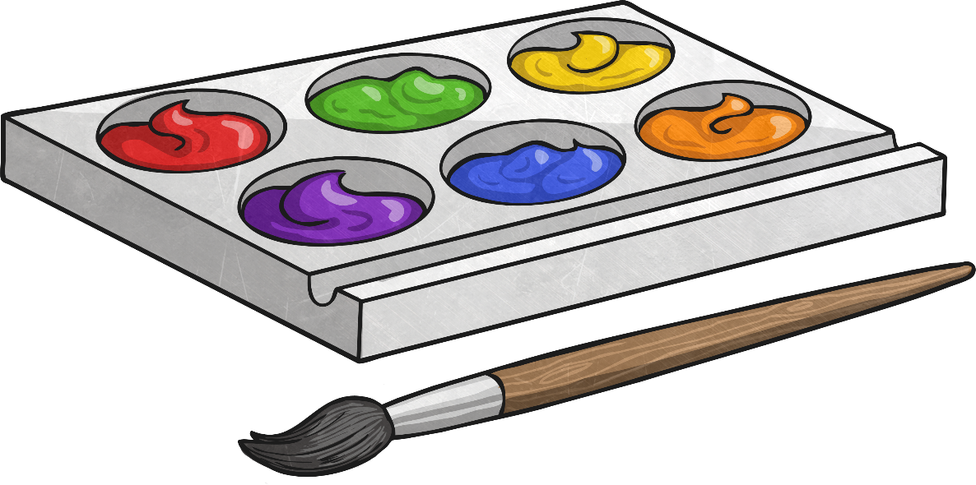
Use of Colour
^{Use a different colour for}
^{each letter.}

Slide 11
Different Sizes
of Letter
Use different sizes of letters to help remember the letters in the word.
^{apple}
^{painting}
^{ApPlE}
^{PaInTiNg}

Slide 12
Shape of Words
^{Draw the shape of the word.}
display

Slide 13
Making Words With Letter
a h k l t y p o
Put a selection of letters in an arc.
See how many words you can make from the letters.
^{H}
^{M}
^{W}
^{L}
^{U}

Slide 14
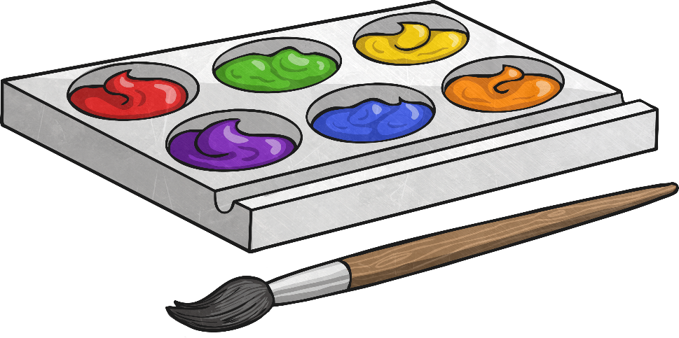
In Sand
^{Or using different materials;}
^{paint, clay, paper.}
^{Using different textures;}
^{sandpaper.}

Slide 15
Visualising
^{Look at your word.}
^{‘Throw’ it at the wall.}
^{Can you still ‘see’ it?}
^{Spell it aloud.}
^{apple}

Slide 16
Writing the Word in Fancy Letters
^{bubble}
^{cursive}
^{cursive}

Slide 17
Look
Say
Cover
Write
Check

Slide 18
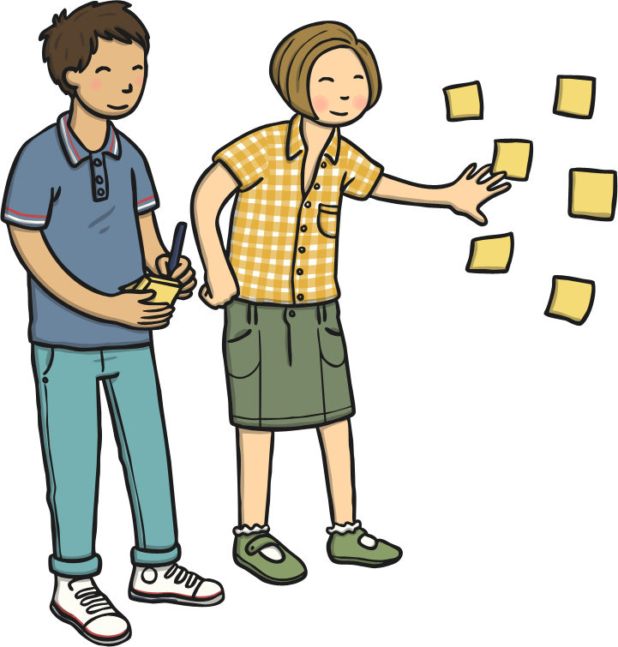
Using Sticky Notes
Place sticky notes in suitable places around the room at eye level.

Slide 19
Recording Your Own Voice
^{Say the word.}
^{Spell the word.}
^{Listen.}
^{Repeat.}

Slide 20
Three Times
Write the word three times and in different colours.
^{cursive}
^{cursive}
^{cursive}

Slide 21
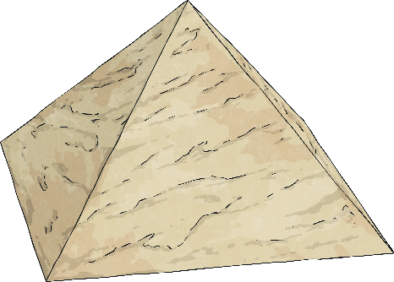
Pyramid Writing
Write your word in the shape of a pyramid.
^{d}
^{do}
^{dog}

Slide 22
Consonant Circles
Write the word then circle all the consonants.
b e l i e v e

Slide 23
Blue Vowels
aeiou
Write the word then go over each vowel in blue.
b e l i e v e

Slide 24
Words Without Vowels
Write each word with a line instead of each vowel. Go back later and fill in the missing vowels.
b _ l _ _ v _

Slide 25
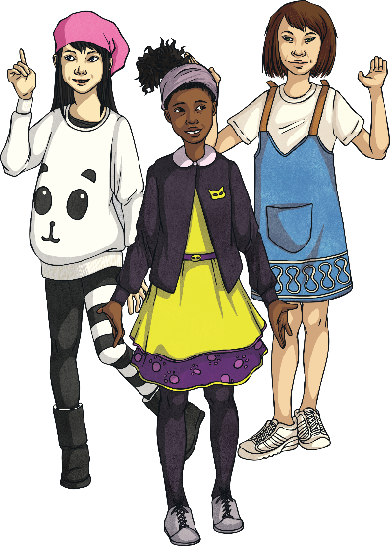
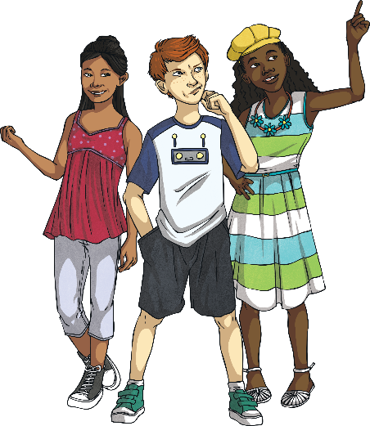
Rallying
The players are two pupils who take turns spelling out words.
The umpire is one pupil who is the reader/checker.

Slide 26
Dictionary Race
In small groups, each with a dictionary, each pupil chooses a word for the others to find as quickly as possible.

Slide 27
Muddled Letters
Pupils rearrange the letters of words making sure to always start with the original letter. Get other pupils to correct them.
^{Yseertyad}
^{yesterday}

Slide 28
Lucky Dip
Pupils take it in turns to take out letters from a bag displaying them in front of them. Carry on until someone can spell one of their words.
^{U}
^{L}
^{M}
^{H}
^{W}

Slide 29
Guess the Word
In pairs, take turns using a wipe board, one pupil writes one letter at a time for another to guess the word. Give extra points for fewer guesses.

Slide 30
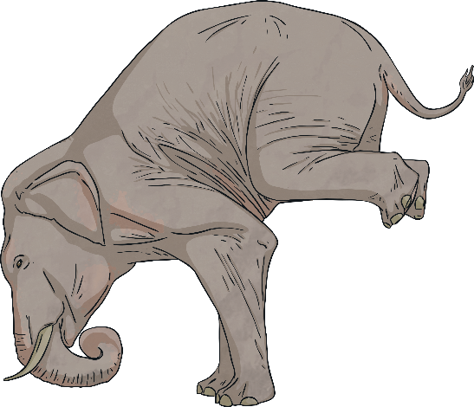
Jigsaw
Teacher chooses a more difficult word. Write the word out 4 times and cut each word up. Pupils have to match the sections together.
^{ele ph an t}
^{e le p hant}
^{elep ha nt}

Slide 31
Word Sort
Pupils have copies of the words that they are learning - one word per card. Clues are read out, pupils have to identify words and place them face down.
^{5 letters}
^{Double consonant}
^{2 vowels}

Slide 32
Line Up
Each pupil holds a letter stand in a line spelling out different words. Change the position of the pupils in the line to spell out the word.
^{spelling}
^{s p e l l i n g}

